Slide 1

Failed Banking Transaction Analysis By Lakshmi Kusma Devi

Slide 2
Fraudulent Transaction Analysis in Banking Systems
In today’s digital economy, fraudulent financial transactions pose significant risks to both consumers and financial institutions.
This analysis focuses on failed banking transactions which can often be indicative of online payment fraud, transaction system abuse, or human error.
The goal is to identify suspicious patterns and failure trends that can help improve security and operational efficiency.

Slide 3
Sources of Transaction Data
Primary Data: 700 transactions from SBI branches across Chennai, Hyderabad, and Kadapa.
Data includes fields like transaction_id, amount, status, error_message, customer_id, transaction_date, etc.
Files were collected from 15 CSVs (from 5 branches per city).
Uploaded to Google Cloud Storage (GCS) and processed using PySpark on a Dataproc cluster.
Only failed transactions were extracted and stored in Cloud SQL, then analyzed using BigQuery.

Slide 4
Data Analysis Pipeline
Data Cleaning: Removed nulls, blanks using PySpark job.
Integration: Combined cleaned data into a unified dataset.
Filtering: Extracted failed transactions for analysis.
BigQuery SQL: Used analytical queries to uncover trends.
Looker Studio: Visualized results with interactive dashboards.
No ML used in this phase, but rule-based pattern detection (frequent errors, repeated customers, high failure branches) was applied.

Slide 5
Fraud Indicators & Observations
~35% of transactions failed — unusually high for daily operations.
Branches in Hyderabad showed the highest failure rate.
Repetitive failure patterns from specific customer IDs and branches.
Certain error messages like "Timeout", "Invalid Account", "Authentication Failed" appeared disproportionately.
Transaction types like "TRANSFER" had more failures compared to "DEPOSIT".

Slide 6
Insights from BigQuery SQL Data Exploration
Total Number of Failed Transactions
Failed Transactions by City
Failed Transactions Over Time (Recent Spike Detection)
Top 5 Branches with Most Failures
Common Error Messages and Their Frequencies
Customers with Multiple Failures
Failed Transactions By Type
Branch-Customer error correlation (Shows how many unique customers failed per branch — helpful in visual fraud hotspots)
Error Message clustering (Which errors are most frequent)

Slide 7
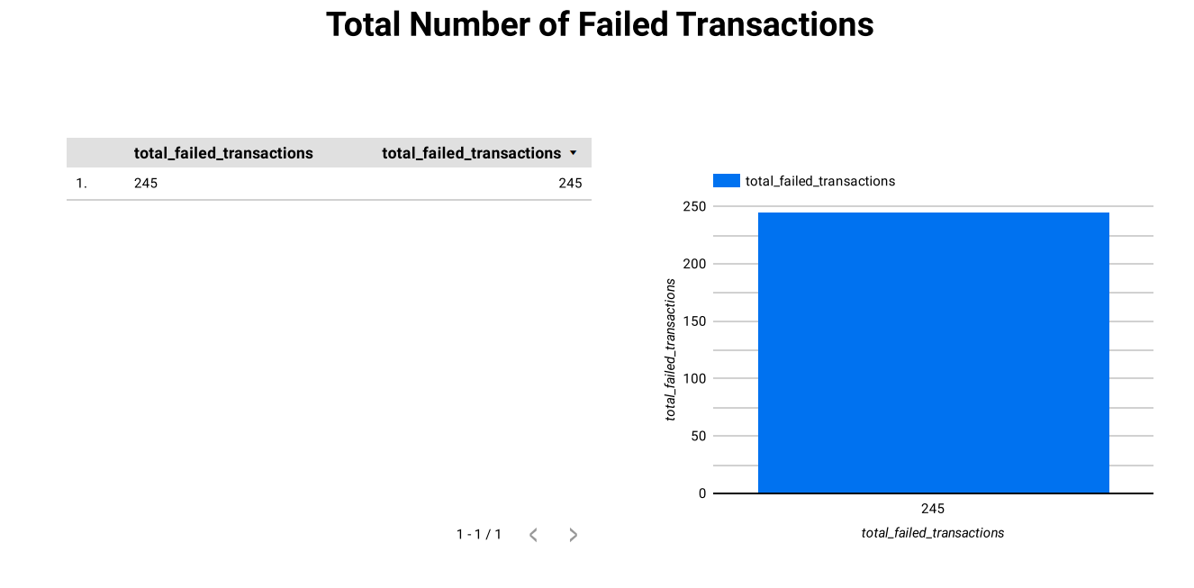


Slide 8
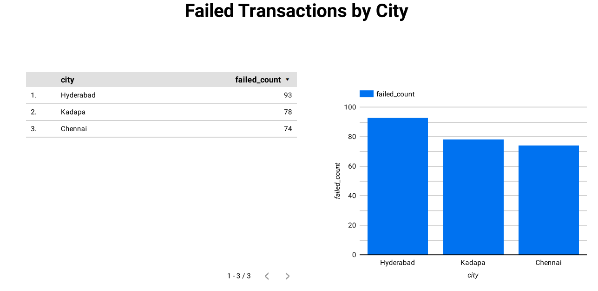

Slide 9
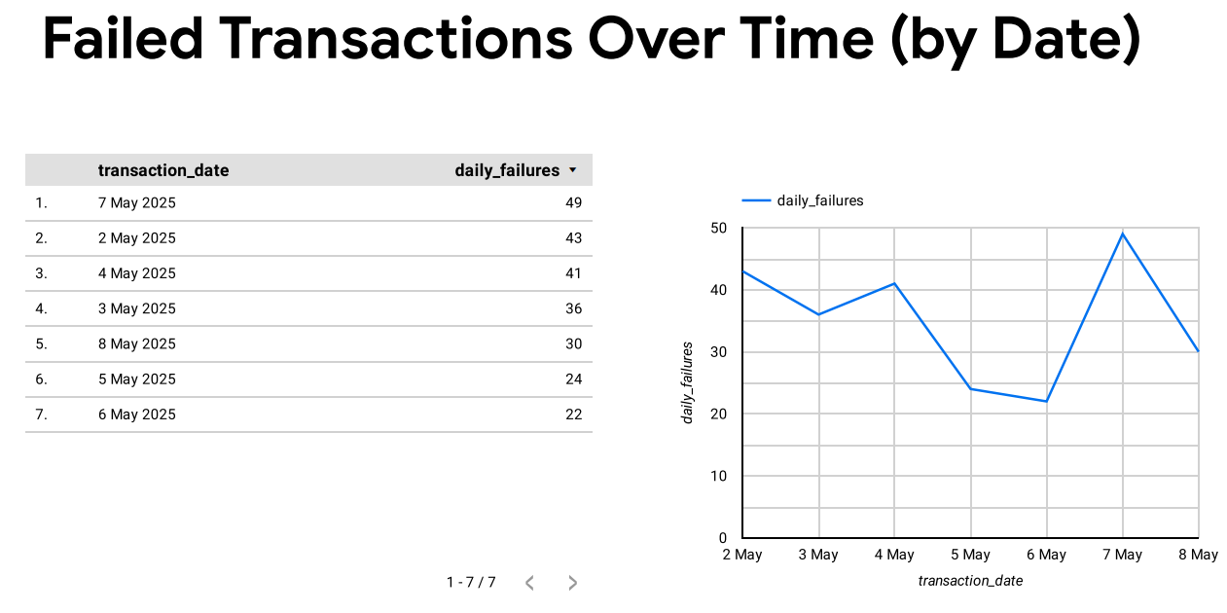

Slide 10
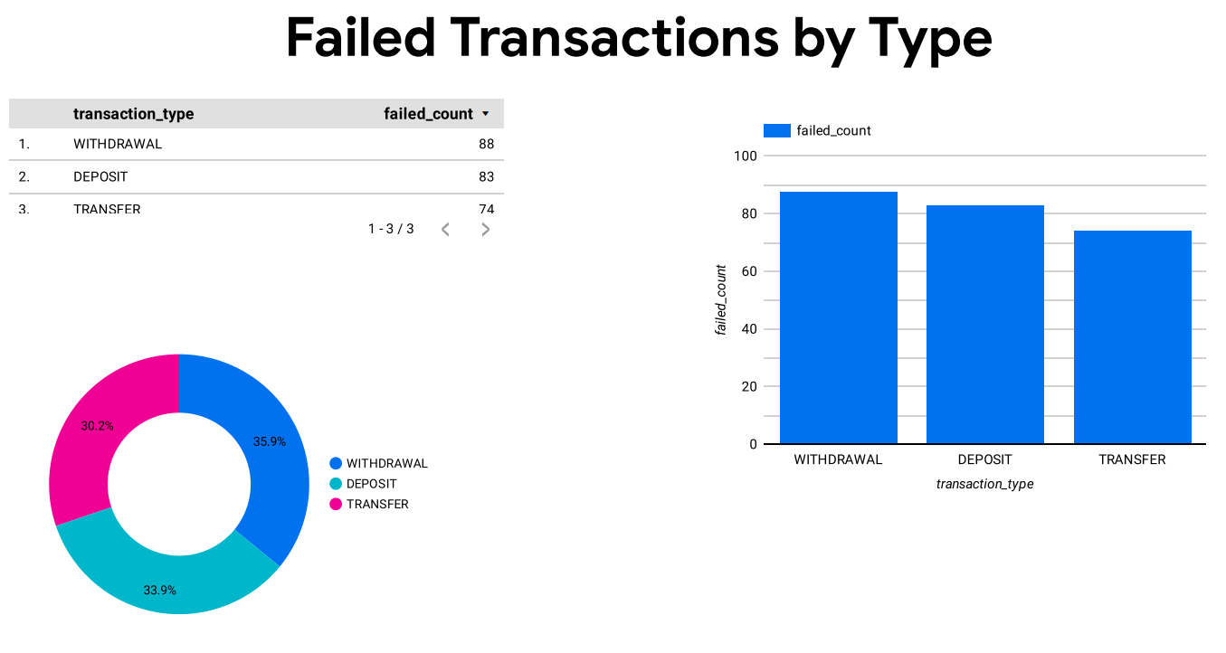

Slide 11
Conclusion
Failed transactions may not always mean fraud, but they give strong clues worth exploring.
This project helped uncover key branches, frequent customers, and common error types that need closer attention.
By using powerful GCP tools like Dataproc, Cloud SQL, BigQuery, and Looker Studio, we built a smart and scalable fraud detection system.
With regular monitoring and smarter rules, we can reduce both financial losses and reputational damage over time.

